Slide 1
CALL
Computer Assisted Language Learning and Its Use in
Reading Instruction for Low Proficiency ELLs
Presented by: Vanessa Benoit, Brenda Fediuk, Alannah Twin

Slide 2
Outline
Introduction
Brain Development
Terminology
Teaching NS vs. ELLs – Is There a Difference?
Language Arts: The Reading Umbrella
History and Barriers
Assumptions

Slide 3

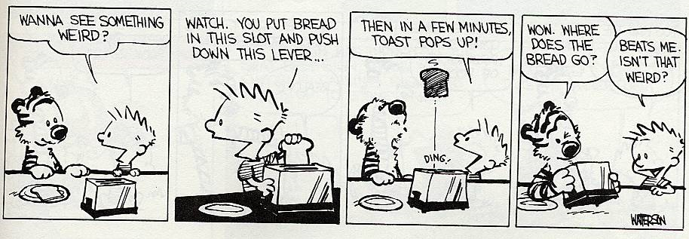
Brain Development
Is there a difference in learning for a low-level ELL at age six and a low-level at age sixteen?
← The Metacognitive Process
(EPEARL, n.d.)
- Yes, because metacognitive processes do not develop in children until up to twelve years old.
This is the ability to plan, monitor and evaluate
- Children range from preoperational to concrete operational stages (up to 12 years old) (Vgotsky, 1978)
Watterson, B. (1988). The essential Calvin and Hobbes. New York, NY: Universal Press, p. 67.

Slide 4
Terminology
CALL – Computer Assisted Language Learning
CAI – Computer Assisted Instruction
CARI – Computer Assisted Reading Instruction
CMC – Computer Mediated Communication (virtual communities)
LPP – Legitimate Peripheral Participation (Vygotsky, 1978)
CCMS – Course Content Management System
LMS – Learner Management System
DAVIE – Dual Assessment Vocabulary Instructor-Evaluator
VKS – Vocabulary Knowledge Scale
SLA – Second Language Acquisition
SLVA – Second Language Vocabulary Acquisition
OLR – Online Reading Lab.
Glosses – a dictionary or link to meaning in L1
Notes:
Situated cognition is based on the experiential theoretical model that learning is functionally motivated. Learner’s knowledge adapts and evolved according to the more experienced and successful model they are emulating in their external environment. Mind centered model where data is internalized through short and long term memory by accessing background knowledge and employing metacognitive strategies.
LPP – is the evolution of the novice learner moving from the outside toward the inside circles with the more proficient old timers.

Slide 5
Teaching NS vs. ELLs – Is There a Difference?
The process for acquiring the skill to read is the same for everyone (Amendum & Fitzgerald, 2011).
Lack of content schema prohibits easy access because comprehension is based on linguistic data (Singha, 1998).
Use L1 if possible to scaffold the L2.
Be sensitive to cultural values and norms.
Teach within students’ realm of experience as it shapes the thinking process of individuals (Ladson-Billings, 1995).
Access background knowledge that is meaningful and relevant.
Consider inter- and intra-group relations when organizing working groups (Daud, 1992).

Slide 6
Language Arts: The Reading Umbrella
Adams (1990) notes that, “Skillful reading is not a unitary skill. It is a whole complex system of skills and knowledge” (p. 3).
Speaking: Oral language is the foundation of literacy. Oral language carries a community's stories, values, beliefs and traditions (Alberta, 2011).
Listening enables students to explore ideas and concepts, as well as to understand and organize their experiences and knowledge (Alberta, 2011).
Writing enables students to explore, shape and clarify their thoughts, and to communicate them to others. By using effective writing strategies, they discover and refine ideas and compose and revise with increasing confidence and skill (Alberta, 2011).
Reading provides students with a means of accessing the ideas, views and experiences of others. By using effective reading skills and strategies, students construct meaning and develop thoughtful and critical interpretations of a variety of texts (Alberta, 2011).

Slide 7
The Whole is Greater than the Sum of its Parts
Each of the "four skills" is composed of component sub-skills. Grabe, as cited in McCarthy (1999), notes six in particular in the case of reading. These are:
The perceptual automatic recognition skill,
Linguistic skills,
Knowledge and skills of discourse structure and organization,
Knowledge of the world,
Synthetic and critical evaluation skills,
Metalinguistic knowledge and skills.

Slide 8
Integration of Skills
When teaching any language skills, according to McCarthy (1999), four necessary elements need continual implementation: scaffolding, learner autonomy, engagement and feedback.
It is hoped that through these complementary and reciprocal processes the outcome will be that the individual “recreate this experience, even when reading alone; it is only by doing this that they may develop their proficiency in the skill of reading” (McCarthy, 1999, p.4 ).

Slide 9
Square Pegs & Round Holes
Although Loucky (2010) attempts to construct a “roadmap to more systematic and successful online reading and vocabulary acquisition”
(p. 225), it is next to impossible to create a one-size-fits-all program, whether it be in the traditional sense of teaching or using technology.
The use of technology provides students with one more arm to create the cognitive foundations for making reading more accessible and for motivatation.

Slide 10
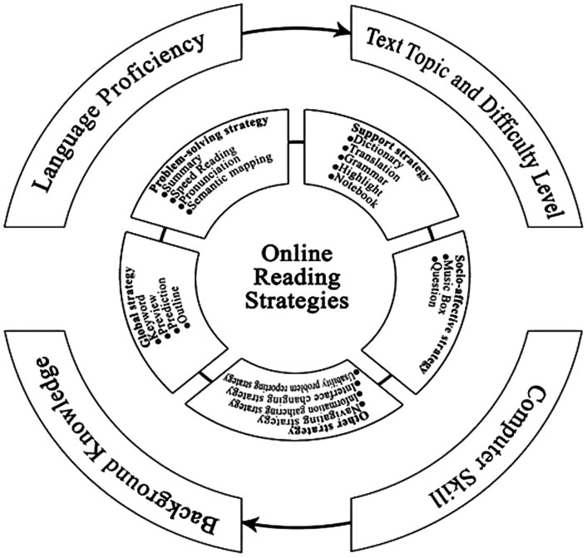
Loucky’s ORS Diagram
(2010, p. 235)

Slide 11
History
Is CALL an effective method to teach reading?
Yes, research supports this as having a positive impact on reading achievement (Soe, Koki, & Chang, 2000).
Computers have assisted in teaching language since 1960 (Lee, 2000)
Behaviourist - 1970: Drill and Kill = PLATO
Communicative – 1980: Generative and Expressive =
reconstruction and simulation software
Integrative – 1990: Socio-cognitive = use of meaningful contexts encompassing all aspects of language (Lee, 2000)

Slide 12
Why Use CALL?
Experiential learning
Motivation
Enhancing student achievement
Authentic materials for study
Greater interaction
Individualization
Broader source of information
Global understanding (Lee, 2000)

Slide 13
Barriers
Financial
Availability of equipment
Technical and theoretical knowledge
Acceptance of technological changes and adaptations
Adverse effects of improper use (Lee, 2000)

Slide 14
Assumptions
CALL overlaps and reinforces skills that the teacher introduces through traditional methods of teaching at each appropriate grade level such as:
  Cooperative learning
  Differentiated instruction
  Peer tutoring
  Learning centers (Lee, 2000)

Slide 15
Division One
Kindergarten to Grade 3
The target students will be ELLs within a regular primary classroom structure typical of most schools. Within this group of students some may be starting from the very beginning of the reading process while others will have more advanced skills and knowledge of the reading process. In both instances students need to be able to decode print and comprehend the printed words (text). This requires a complex set of interrelated skills which fall within the two categories of linguistic knowledge and background knowledge.

Slide 16
Aims and Limitations
The aim of this presentation is to outline the skills and knowledge necessary to help students become readers and to engage students in the reading process through the use of Computer Assisted Language Learning.
The limitations of this presentation are that it will not demonstrate how to use any particular program, but computer resources will be listed at the end of the presentation.
Notes:
Rationale…

Slide 17
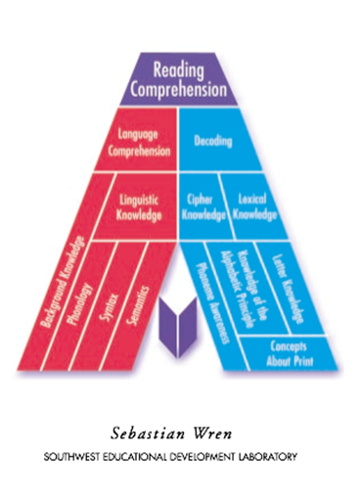
Cognitive Framework

Slide 18
Reading Skills and Related Definitions
Language Comprehension is the underpinning of reading comprehension. A reader first must understand the language to derive meaning from the message in the text. There are implicit and explicit messages within formal and informal contexts of language.
Decoding is the act of reproducing the letter sounds, for regular and irregular words, in a smooth and connected manner to create the proper pronunciation of a given word. When decoding is fluid and accurate effort can go to understanding the text (Hoover & Gough, 2011).

Slide 19
Knowledge
Cipher knowledge is the understanding of the conventions and connections between the way a word is spelled and the way a word is pronounced. The “regular and consistent” application of this knowledge is necessary for decoding because it is not simply a process of assigning individual sounds to individual letters. This would be an example of deciphering. It is best to start teaching the regular words that follow the conventional rules before going on to the irregular words (Hoover & Gough, 2011).
lexical knowledge is best described as an ever increasing bank of words and expanding knowledge developed about them over time for future reference and application to the acquisition of new vocabulary (Hoover & Gough, 2011).

Slide 20
Awareness
Phonemic Awareness is the simplest unit of sound in a language, which falls under the umbrella of the broader concept of phonological awareness. The word cat has 3 letters and each letter is represented by a sound /c/a/t/, whereas the word vision has 6 letters and is represented by 5 sounds /v/i/zh/o/n/ (Hoover & Gough, 2011).
Knowledge of the Alphabetic Principle is an understanding that the sounds of a language are represented by symbols called letters (Hoover & Gough, 2011).

Slide 21
Concepts
Letter Knowledge is the recognition of symbols used in reading and writing to represent language (Hoover & Gough, 2011).
Concepts about Print in the English language include the understanding that there is a message in text, text is read from left to right and top to bottom, and that there are mechanical principles to the organization and structure of words and sentences (Hoover & Gough, 2011).

Slide 22
Fostering good vocabulary development
Loucky (2010) cites Blachowicz and Ogle, who state that institutes need to have a comprehensive, integrated, school-wide approach to vocabulary in reading and learning by
1) creating language and word rich learning environments,
2) intentionally teaching vocabulary from a carefully selected and principled approach and
3) developing word-learning strategies proven to be effective in helping learners retain and use new words.
Discovery and consolidation strategies are sequences of teaching events and teacher actions, which make the steps that enable a learner to achieve an outcome explicit, such as:
a) procedures to facilitate word learning at a desired level of understanding and
b) independence in the implementation of word learning strategies

Slide 23
Steps to Introducing Phonics
Phonics Primer
“You can use this Phonics Primer developed by The National Right to Read Foundation to begin teaching a child or adult to read today. This primer lists the 44 sounds in the English language and then gives steps for teaching those 44 sounds and their most common spelling patterns. In addition to learning sounds and spellings, each day the student must read lists of phonetically related words and spell these words from dictation. Phonics instruction must be reinforced by having the student read decodable text” (Elam, 2005, p. 1).

Slide 24
Steps 1 - 5
Step 1. Determine the CALL program you are going to use. Plan and direct students to the aspects of the program they will use and the sequence you would like them to follow.
Step 2. Teach the 5 short-vowel sounds and consonant sounds. Drill until memorized.
Step 3 Practice two-letter blends. Drill until blending is automatic.
Step 4. Practice three-letter blends. Drill until blending is automatic.
Step 5. Teach the twin-consonant endings, plurals, and two-consonant blends. Drill until blending is automatic. (Elam, 2005, pp. 2 - 5)

Slide 25
Steps 6 - 10
Step 6. Teach the digraphs (ch, sh, th, wh, ng, nk). A digraph consists of two consonants that form a new sound when combined. Also teach three-consonant blends.
Step 7. Introduce a few high-frequency words necessary to read most sentences. Dolch words
Step 8. Teach the long-vowel sounds and their spellings. Note that there are five common spellings for each long-vowel sound. Also teach the “Silent-e Rule”: When a one-syllable word ends in “e” and has the pattern vce (vowel-consonant-e), the first vowel says its name and the “e” is silent.
Step 9. Teach the r-controlled vowel sounds and their spellings.
Step 10. Teach the diphthongs /oi/ and /ow/ and their spellings. A diphthong consists of two vowels that form a new sound when combined. Also teach other special sounds.
(Elam, 2005, pp. 6 - 9)

Slide 26
Steps 11 - 15
Step 11. Teach /aw/, /awl/, /awk/ and their spellings.
Step 12. Teach these sounds and spelling patterns.
Step 13. After 3 to 4 months of daily phonics instruction, begin introducing decodable stories.
Step 14. Begin introducing “easy-to-read” books.
Step 15. Continue to give phonetically based spelling lists.
(Elam, 2005, pp. 9 - 10)
Notes:
The less transparent the orthographic grain size the less reliable phonics is as a means of word decoding and it should not be the only approached used. 2 other methods are analogizing (comparing the word to a word you already know) and predicting (according to the context and what makes sense).

Slide 27
Questions to Understanding
Asking questions and looking for answers -
before I read
as I read
after I read.
I wonder... I was confused when...
How could that be? Why do you think?
Who... What... Where... When...
(Kump, n.d., Asking questions poster)

Slide 28
Determining Important Ideas
I understand the main ideas of the text and what the author's message is.
The text was mostly about...
The author is trying to tell us that...
I learned...
The important details were...
(Kump, n.d., Determining poster)

Slide 29
Super 6 Reading Strategies
1. Making Connections – to background knowledge
I know…about this topic.
Good readers interact with the text and bring their experiences to what they read.
Students make three types of connections:
  relating text to self (personal experiences)
  relating text to other texts (one book to another)
  relating text to the world around them
  (Oczkus, 2004)
Notes:
Create Class Strategies posters

Slide 30
2. Predict/Infer
Predicting while reading requires some intuition, but predicting
is also based on using one’s experiences, solid clues from the
text, and the ability to anticipate what could logically happen
next.
Ask “What do you think will happen next?” Read on to see if that happened.
Inferring involves complex thinking.
When students infer they act as detectives gathering logical clues to piece together the solution to some mystery.
Another way to say inferring is “reading between the lines”.
We use clues to infer what authors mean when they don’t explicitly tell us in the text.
(Oczkus, 2004)

Slide 31
3. Questioning
Self-questioning before reading peaks the reader’s interest and gives purpose to reading.
Questioning during reading provides clarity and predictions to keep the reader engaged.
Good questions words are: why, how, when, where, who and where.
(Oczkus, 2004)

Slide 32
4. Monitor and Clarify
Good readers constantly make sure they understand what they are reading.
Good readers correct mistakes in understanding by rereading and looking for answers to what is confusing them.
Good readers make sure they understand the meaning, and stop to figure it out when they don’t understand.
Rereading is a good idea!
(Oczkus, 2004)

Slide 33
5. Summarizing
Summarizing involves remembering what one has read, selecting only the most important points to share, and ordering those in a logical manner.
When students summarize, their comprehension improves.
Retelling is important – have students practice retelling.
Retell the reading in order.
(Oczkus, 2004)

Slide 34
6. Evaluating: Making Judgments
When readers evaluate, they judge and defend their opinions of the text, rank important ideas, critique the author’s writing, rate the book, and decide if they did well as a reader.
Ask your child, “Did you like the book? Why or Why not?” Also, ask “What is your favorite part? Why?” “What is your least favorite part? Why?”
This information is from the book Super 6 Comprehension Strategies, by Oczkus (2004).

Slide 35
Division Two
Grade 4 to Grade 6
The target students in this division are the same as Division One, consisting of ELLs within the context of a typical classroom setting. Resources for this group will focus on Computer Assisted Language Learning resources. These are resources used to assist students to learn how to read. The resources are aimed at students who are at a low proficiency level, although resources range from low proficiency to advanced proficiency.

Slide 36
Tips for selecting good sites/programs
One of the top recommendations for a good program is that it should have the ability to be monitored in some way to adjust the lesson to the learners needs and advancements. An ideal program would adjust the reading levels and sequencing of words that need to be learned by each learner’s vocabulary and reading ability, and then repeating exposures in varying new contexts until the material has been learned.
(Loucky, 2010, pp.226, 229)

Slide 37
Tips Continued
Programs should have varying levels of instruction allowing students to choose the program that fits their level of proficiency.
Programs should be able to track, archive, and assess at least some of the students’ learning.
Programs should provide repeated exposure over timed intervals also known as spaced repetition in order to allow for the material to be preserved in long-term memory permitting for better retention.
(Loucky, 2010)

Slide 38
Resources For Division 2
Story Place – The Children’s Digital Library
Provides children with the virtual experience of going to the library.
Children’s books that are designed to teach children reading and listening comprehension.
Books teach about colors, numbers, and other topics.
Each title includes an interactive story, a print-out activity, and a related reading list.
(Mecklenburg, 2010)

Slide 39
One Stop English – An Interactive Website
Over 7,000 resources including lesson plans, worksheets, audio, video and flashcards.
Clear step-by-step teaching notes.
Suitable for standalone instruction.
Resources are clearly marked by age and level.
Lesson plans, activities, exams, grammar, skills (listening, reading, pronunciation, vocabulary, speaking, and writing) Content and Language Integrated Learning (CLIL), support, games, and an online community.
All levels and ages available.
(OneStopEnglish, 2011)

Slide 40
Rosetta Stone
Over 31 languages to choose from.
Engages students in lifelike conversations.
Review material.
Interactive speaking activities.
Interactive grammar and spelling activities.
Easy-to-use reports and graphs.
Audio Companion CDs.
Online version (RosettaStone, 2011).

Slide 41
International Children’s Digital Library
A collection of more than 10,000 books.
Over 100 languages.
Free.
Focus is on identifying materials that help children to understand the world around them.
Can be searched by age and other categories.
Some books are available in more than one language.
Text of both languages are visible.
(ICDL, n.d.)

Slide 42
ESL Gold
Vocabulary pages.
Practice conversation skills.
Hundreds of pages of free material.
Organized by skill and level.
Vocabulary study and quizzes.
Grammar and pronunciation exercises.
Speaking practice.
Games.
Activities.
Lesson plans.
Handouts.
(ESLGold, 2010a)

Slide 43
The Oxford Picture Dictionary: CD-ROM
3,700 words
All words have sound, animation, and color.
Hear, read, say, and spell words.
Zoom in for close-ups of the word.
Ample language practice.
Games.
Flashcard maker.
Randomly-generated tests.
Progress reports.
Teacher Management System.
(ESLGold, 2010b)

Slide 44
Pronunciation Power 1
Beginner to intermediate learners.
Translations in 12 languages.
Over 7000 practice words.
Thousands of sentences.
Over 100 hours of training.
Over 2000 photos and graphics.
Animated lessons.
Over 1000 listening exercises.
Practice S.T.A.I.R.
Interactive games.
(ESLGold, 2010c)

Slide 45
Understanding and Using English Grammar
Multimedia grammar.
Advanced audio and “record and compare”.
Exercises include – drag and drop;
  Audio response;
  Listening;
  Reading;
  speaking activities;
  Games.
A test at the end of the chapter.
Progress Reports.
Part of the ESL Gold website (ESLGold, 2010d)

Slide 46
LexTutor
Expanding English vocabulary.
Diagnostic vocabulary tests.
Corresponding set of vocabulary lists.
Linked to a concordance, dictionary, and quizzes.
Cloze exercises.
Make your own Cloze exercises.
Text-to-speech.
Audio of a word or phrase.
(Cobb, n.d.)

Slide 47
Word Champ
Student or teacher use.
Flashcards.
  Pronunciation
  reading practice
  picture flashcards
  listening comprehension
  Verbs
  Antonyms
Tracks your words
Web Reader
(WordChamp, 2012)

Slide 48
Free English Study, Speak English Today, and ESL Gold
Sites are amalgamated.
Speaking.
Listening.
Reading.
Writing.
Grammar.
Vocabulary.
Pronunciation.
Idioms.
Low beginner to advanced instruction.

Slide 49
iPhone/iPod Apps
Pocket English (ESL) - Beginner I 1-10
Listening skills
Reading
Speaking
Pronunciation
Vocabulary
Grammar
Line-by-line audio
Review track
Vocabulary list and flashcards
Expansion sentences
Grammar points (Apple, 2010c)

Slide 50
iPhone/iPod Apps Continued
Kaplan TOEFL Vocabulary Flashcards
More than 350 words
Synonyms
Sample sentences
Features:
  Audio
  Definitions and example sentences
  Flashcards
  Quizzes (Apple, 2010b)

Slide 51
iPhone/iPod Apps Continued
VocabWiz TOEFL
500 frequently tested vocabulary words.
Reads texts to you.
Text and audio all in one.
Professionally recorded.
Flashcards.
"Play" mode.
Multiple choice and Hangman quiz.
Individual tailoring.
Example sentences (Apple, 2010d)

Slide 52
iPhone/iPod Apps Continued
A+ English - Speak & Read + Audio books
11 books plus audio.
Improves speaking, listening, and reading skills.
Integrated with audio download manager, player, and voice recorder.
High quality.
Voice Recorder.
Automatic playback.
Can be used anywhere (Apple, 2010a).

Slide 53
Online Games
Digital Dialects
Learn numbers, colors, food, clothing, fruits and vegetables, animals, vocabulary, and verbs.
Visual and auditory.
Language Games.org
Online games such as:
  Word Seek
  Crossword Puzzles
  Hangman.
  (Language Games, n.d.)

Slide 54
Online Games Continued
Transparent Language
Based on well-known, classic board games.
Combine the nostalgic fun of playing popular games and the opportunity to sharpen foreign language skills.
Games include:
  Word Seek,
  Unscrambling words to form a sentence,
  Plug-n-Play – a fill-in-the-blank game,
  International Cafe.
  (Transparent Language, 2011)

Slide 55
Division 3 – The Metacognitive Thinkers

Slide 56
In Division 3, grades seven to twelve, most students will act at the formal operational stage.
For learning an L2, we can assume that the student has a normal to strong grasp of their L1. This means proficiency or understanding of the following in the realm of reading:
Syntax
Rules of constructing sentences
Grammar
Semantics
Connotation vs. denotation
Thematic roles (agents, patients etc.)
Discourse analysis – the way of analyzing a written language
Homonyms, synonyms, antonyms
Pragmatics
  Meaning in words and sentences
Morphology
  Word roots
  Affixes

Slide 57
And the differences in strategies for teaching ELLs vocabulary?
→Discovery Strategies
Consolidating Strategies
Loucky, 2010

Slide 58
Discovery
Consolidating
- First time
Never seen before
Attending
Assessing
- Acquiring
Accessing
Meaning
Archiving
Analyzing
- Associating
Second time or more
Ensuring acquisition for new words
Anchoring (Short term)
Associating (Long term)
Activating
Reviewing
Recycling
Reassessing
Relearning
Predicting
Producing
Using
Loucky, 2010

Slide 59
Archive
A student’s and teacher’s way of evaluating and keeping track of progress
    Behavioural Archives keep record of the student’s feelings throughout the program and Archives hold the overall progress of the student.
    This can be teacher monitored and directed, and student evaluated and used
Account Required
Moodle.com
  Allows teachers to create elaborate online communities set for learning
  Able to deliver content via many other resources such as Wikis and monitor activity

Slide 60
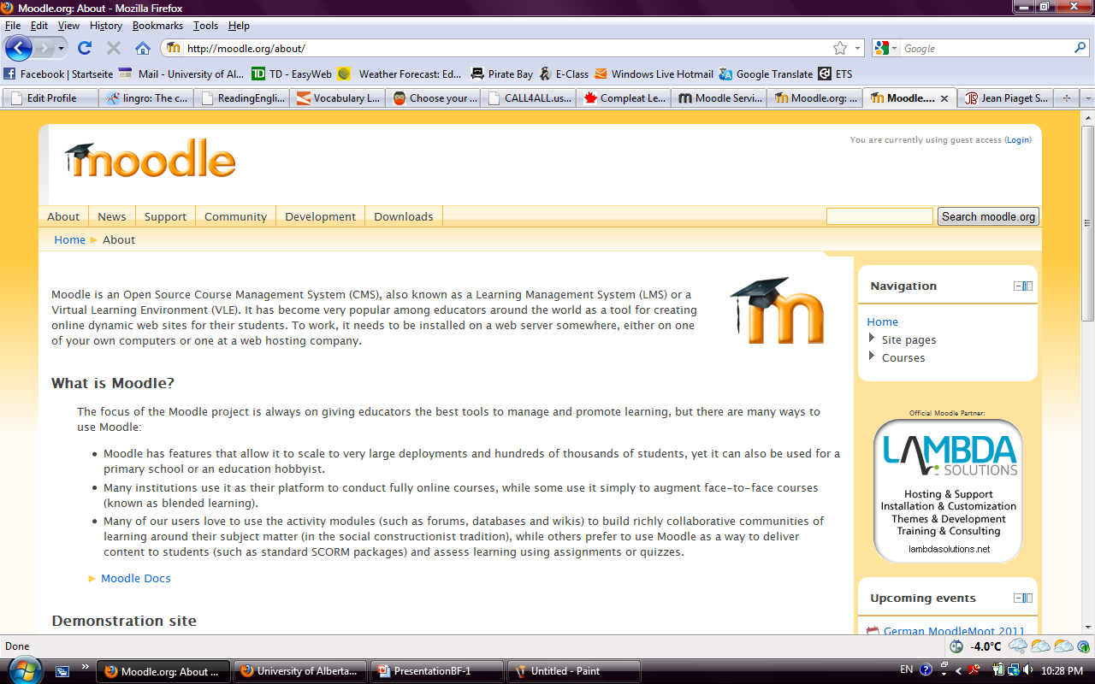
Screen shot taken from http://moodle.org/about/

Slide 61
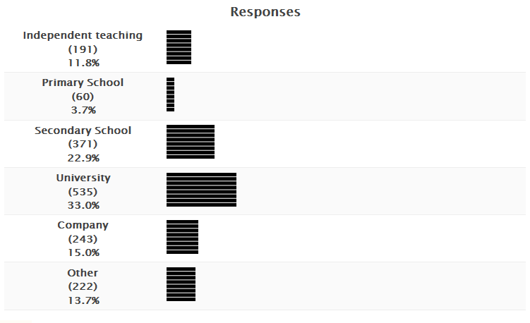
Moodle Survey: Where do you use Moodle?

Slide 62
Meaning
How do ELLs acquire meaning in new words?
WordChamp (2012)
  Allows students to review and recycle words
  L2 to L1 or L1 to L2 in over 130 languages
  Uses flash cards as drill method of instruction
  Free!
Meaning is context based, students may acquire new words, but do they know the various meanings of a word?
Methods of discovering meaning:
Drill instruction via. Flash Cards
Web Reader – Allows ELLs to access meaning with an online dictionary as they read through various foreign websites.
Absolute Recall: More of a review and recycle method, it allows students to review up to fifty words a day until they are absolute.

Slide 63
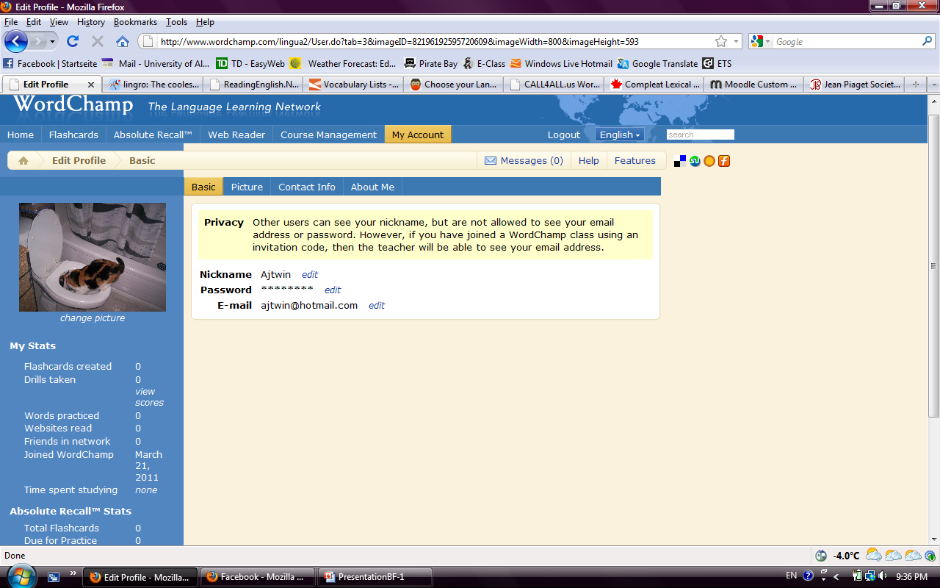
(Word Champ, 2012)

Slide 64
Acquire
Acquiring words is discovery based, meaning discovered when reading an L2 text. The word is not directly taught, but unlike analyzing, students need to look up the meaning.
Acquiring is inter-related to meaning, as will be seen in the next definition.
When students don’t know a word in their L2, Lingro.com allows them to find the meaning in their L1 just by clicking on the word.
Students have more access to meaning and might be able to eventually analyze and associate words.
Account Required
Student Use with teacher direction

Slide 65

(Lingro, n.d.)

Slide 66
Analyze
ELLs should eventually be able to analyze a word and derive the meaning from the context of the situation rather than using a dictionary.
Readingenglish.net provides many strategies in doing this process.
The provided example below shows some words with multiple morphemes, if students know the root word and the affixes, they may be able to derive the meaning on their own.
To analyze may also refer to pragmatics and discourse analysis. The ability for a student to derive meaning and understanding through context, or without looking up the definition of the word in L1 or L2 (Ghadirian, 2007).
Account Required Student Use
Warning: Site contains American content, only to be used in L2 learning, not curriculum content

Slide 67
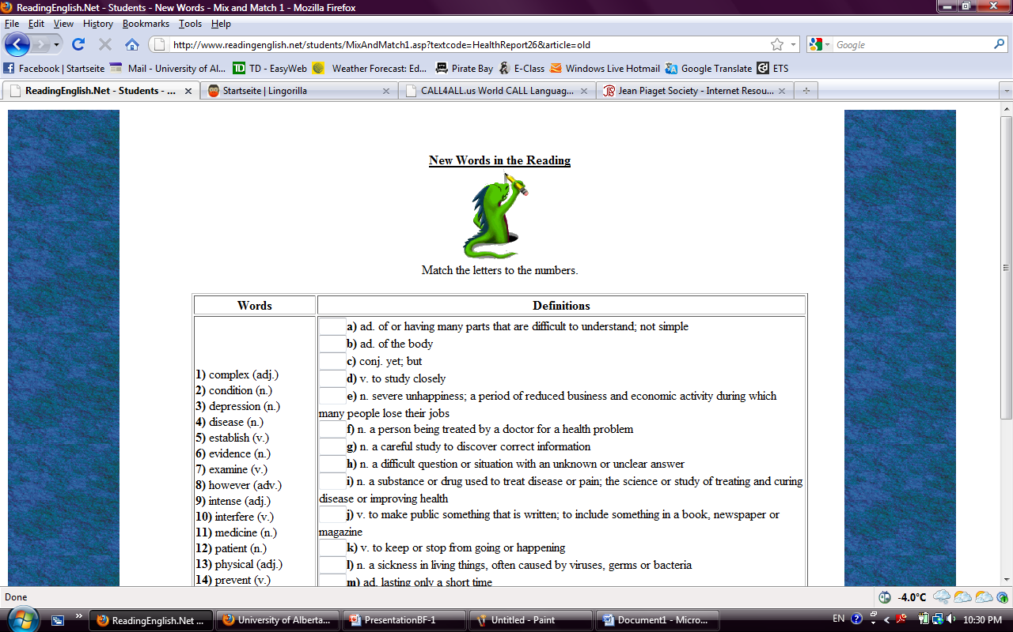

Slide 68
Anchoring and Associating
To anchor a word means to stay in long term memory even if the word is not frequently used. To associate a word means knowing the meaning of another word and to be able to relate it with other words. Association is used as a discovery strategy, meaning seeing a word for the first time, and as a consolidating strategy.
Vocabulary.com (2012) provides thousands of families of words for students to view; a student can search one word and be linked to twenty more.
This type of vocabulary is key for comprehension in content specific courses, i.e. Science, Math, etc.
It allows to ELLs to associate words with other words via word maps, thus students are able to anchor new words based on connections. Both of these key words, anchoring and associating, have long term memory effects on the student.

Slide 69
Strategies and uses of Vocabulary.com
Their slogan is “Animate your Vocabulary”, which is exactly what it does. Though its focus is on associating words with other words, it has strategies that are discovery and consolidating based.
Searching one word provides twenty other words, so ELLs are able to acquire and associate
It does not provide the definition of a word, but may provide situations in which the word is used, so students can analyze
Word families are already made, which are useful for subject learning, ie. Math, Science, as well there are pre-designed lesson plans to work in conjugation with online material
Provides links to many other useful sites for vocabulary resources
Student Use with teacher guidance (Vocabulary.com, 2012).
Free! No account required

Slide 70
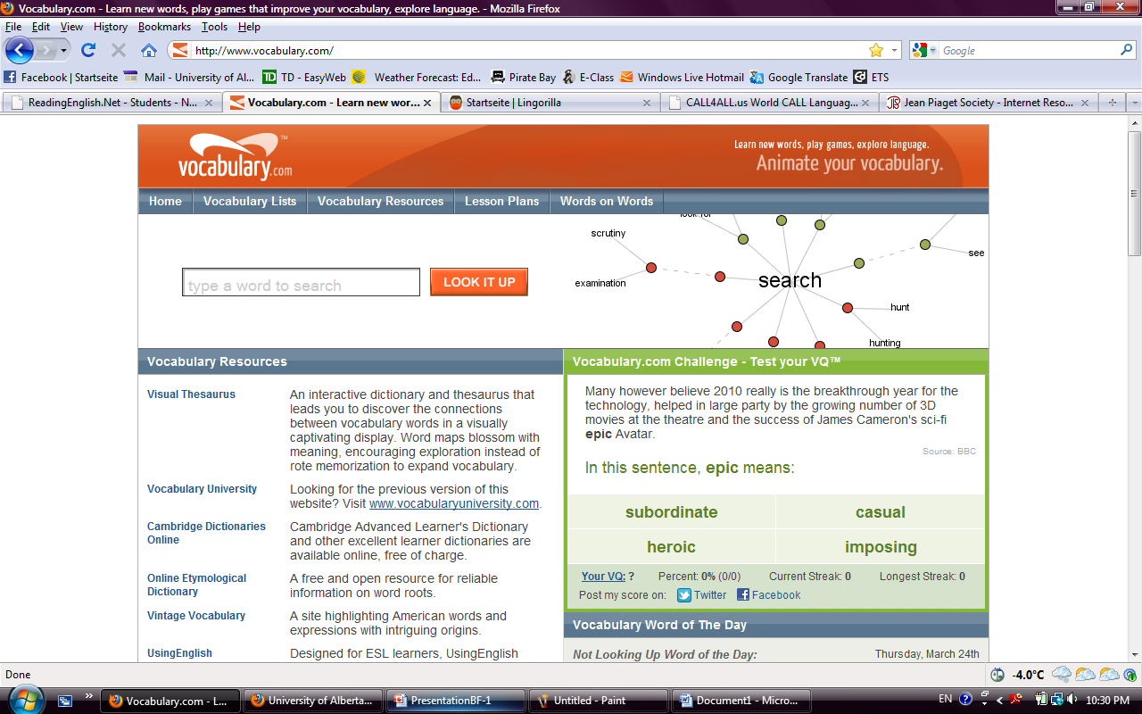

Slide 71
Activation is not used immediately with beginner ELLs, but after the previous strategies.
Activate
Students will soon need to realize that they can add to root words.
i.e. interesting, → uninteresting
At older ages, morphology can be activated in a student. Lextutor.ca (Cobb, n.d.) provides explicit ways in how morphology works. It also works with teaching pragmatics, i.e. Mary ate an apple. Mary is the subject, apple is the object, ate is the simple past verb
Example programs within Lextutor.com
Familizer – Takes words from a text and organizes them into families.
Key Words Extractor – Takes the text used and finds the key words, ie. Subject, object, agent etc.
Morphology – Words are divided into their roots, affixes and how frequently they occur.
Lextutor.ca (Cobb, n.d.) needs to be teacher directed, the overall design and layout of the site is confusing and disorganized, though its content is useful.
Free!

Slide 72
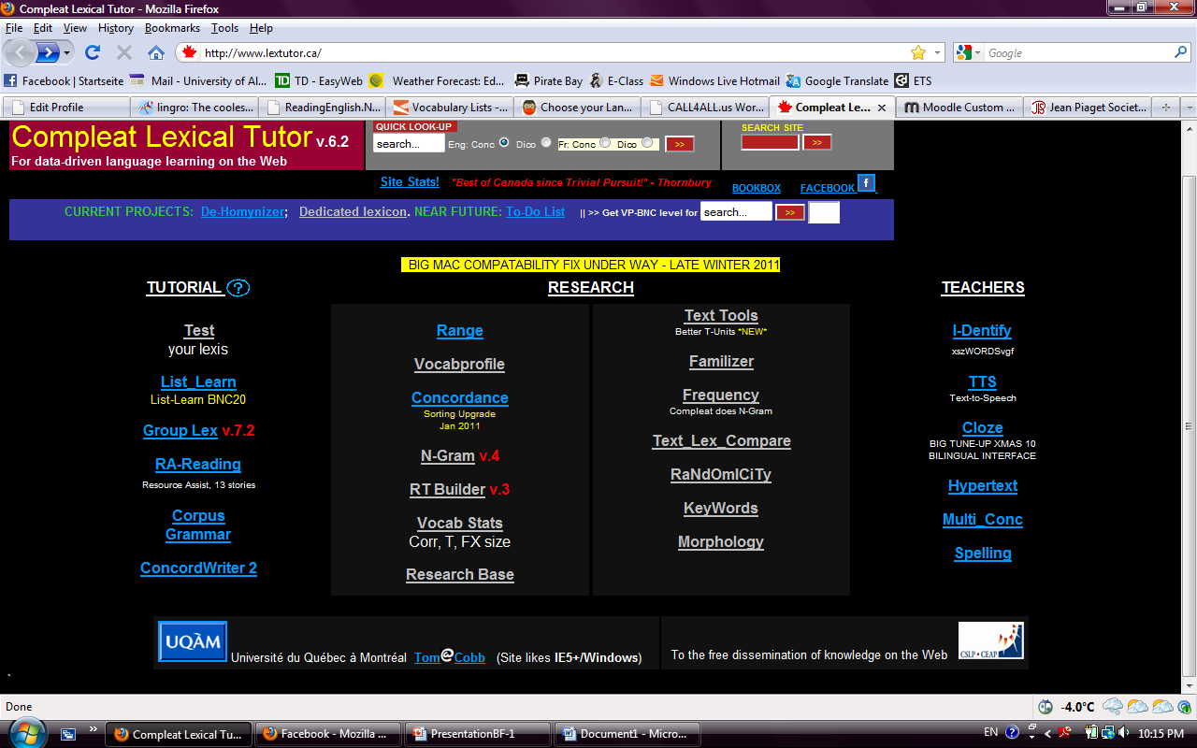

Slide 73
Recycle
At this point in the process, ELLs are recycling old words often, hence Recycle. Strategies that were once assessed, for example, become reassessed. For continuous learning of vocabulary and reusing the old ones, a program is needed that is updated frequently with new material.
Lingorilla.com (2012) provides the ongoing need of new material and a social environment for students to relearn old materials and new ones online.
It has:
Lessons
E-Cards and flashcards
Exercises
Quizzes

Slide 74
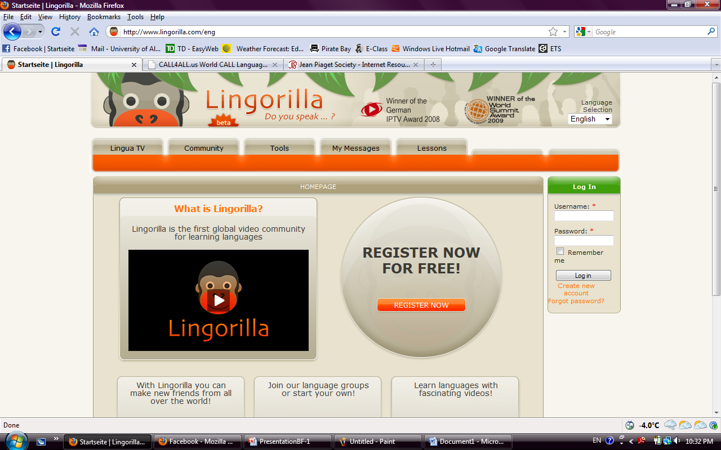

Slide 75
Implications
Every good reading program has to be under the direction and supervision of the classroom teacher who effectively monitors, evaluates and sets the direction for specific, sequential and systematic teaching (Hayward, 2011).
Teachers have to be aware of avoiding the possibility of confusing students with contradictory information and neglecting student error that could fossilize into information that later has to be unlearned.
Methodology is more than introducing software and allowing it to act as a substitute teacher (Daud, 1992).

Slide 76
Benefits
Benefits are that instruction can be individualized, specific and systematic according to each student’s pace and fit within the greater scheme of classroom instruction and activities. For example, the teacher could work with a small group of students or the whole class while other individuals work at their computer generated lessons.
The beauty of CALL is the immediate feedback it provides each student. In addition, you can track progress over time manually or it may be built into specific programs.

Slide 77
Computer Literacy Skills for Students
The teacher must train all students in the use of programs as a whole group in the school computer lab.
All the programs can be bookmarked on the computers for easy accessibility.
Computer technology is a new way of thinking and learning and can be just as difficult as learning a second language, so it is important to plan for the proper introduction and use of this resource (Daud, 1992).

Slide 78
Student Training
According to Daud (1992), classroom management and student training have as much to do with the success of CALL as adequate teacher training.
He attributed this to the “quality of teacher talk” in connection with the time individual teachers took to introduce a lesson and the time devoted to addressing individuals, small groups, and the whole class during a lesson period.

Slide 79
What is your target use?
There are three basic purposes according to the goals and outcomes devised for the time, arrangement or grouping of the students at the discretion of the teacher (Soe, Koki & Chang, 2000).
Drill and practice, tutorials or dialogue.
Integrate curriculum to make reading a more meaningful task that provides students with the opportunity to acquire academic language.

Slide 80
Strategies
Partnering students with more proficient learners is a strategy that allows for diversity and creates independence with self-directed programs.
Strategies can only be as effective as the individual teacher orchestrating them.
A credible teacher needs to make ongoing and direct connection to the curriculum and students’ knowledge of the structure of the language (Daud, 1992).

Slide 81
Instructional Implications
According to Loucky (2010), ten instruction implications are clearly specified to ensure a reader’s comprehension when teaching. These implications will be indirectly addressed throughout the presentation.
1) Ensure fluency in word recognition.
2) Emphasize learning vocabulary.
3) Activation of background knowledge.
4) Ensure acquisition of linguistic knowledge and general comprehension.
5) Teach recognition of text structures and discourse organization.
6) Promote development of strategic readers, no strategy checklists.
7) Promote extensive reading.
8) Build reading fluency and rate.
9) Develop intrinsic motivation for reading.
10) Contribute to a coherent curriculum for student learning.
(summarized from Chun, 2006, Table 1, p. 71)

Slide 82
Issues and Concerns
According to Soe et al. (2000), research is new in this area and inconclusive due to the scarcity of acceptable studies in many categories. Although there have not been any studies that report that CALL is faulty or detrimental, this does not mean that it is effective.

Slide 83
With technology comes the cost of security and safety for students: How can a teacher prevent the harmful uses of the world wide web?
Blocking programs will inhibit the educational use of computers in the school such as Facebook, MySpace and other gaming and social networking sites. This process can be set up through the school librarian or technician.
Allow programs that contribute to learning and have them in the Bookmarks (Firefox) or Favourites (Internet Explorer) tab for easy access (shown on next slide).
Programs such as YouTube cannot be blocked because of its worldwide use in many internet sites. Its use is more beneficial than negative.
Though parameters can be set, constant supervision is required around the use of a computer.
Any technical problems should be addressed by the school librarian or technician. It should be assumed that these types of problems will occur infrequently, therefore a backup plan should always be prepared in the absence of a computer.

Slide 84
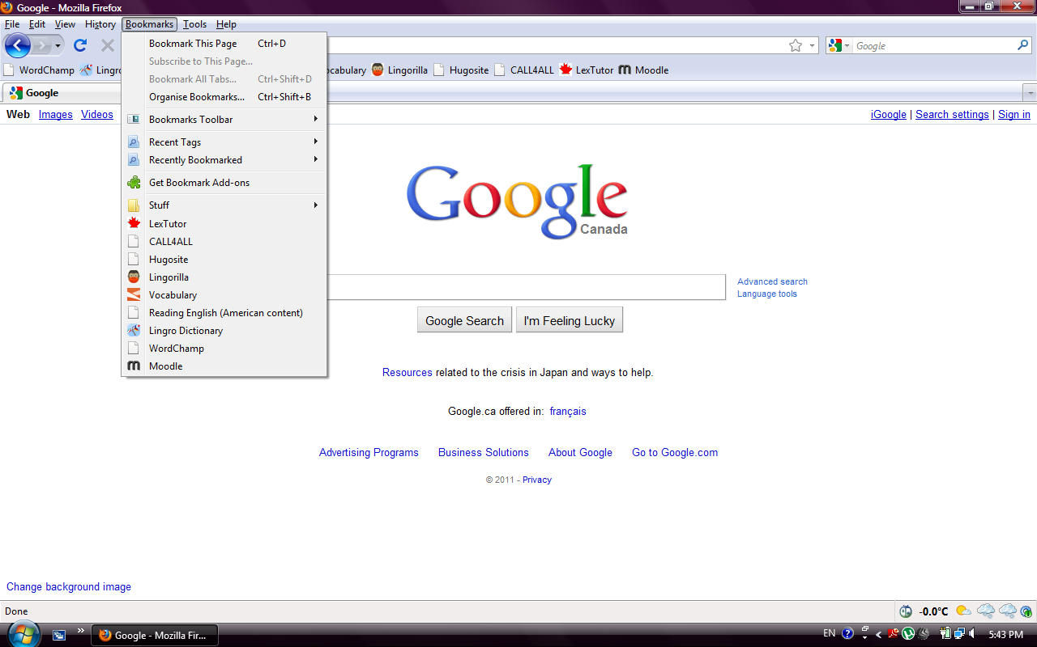

Slide 85
Further considerations
Explicit instruction in the physical presentation of text and/or text structures facilitates reading comprehension (Simmons & Kameenui, 1998).
Many variables need to be considered to determine the effectiveness of CALL; it is not a simplistic solution (Chapelle & Jamieson, 1986).
Students’ learning styles and preferences need to be considered.

Slide 86
Critical Role of the Teacher
Being apprised of the latest research, be self-proficient in the use of technology and knowledgeable about the appropriate implementation of CALL.
There are specific kinds of computers and programs predetermined by the school and one has to work within those parameters. Familiarize yourself with these materials and take advantage of them.

Slide 87
What can WE do with CALL?
With the proliferation of rapidly changing technology, whether one is using free web-based programs, or packaged software programs installed in site based computers, each resource must be carefully screened, prepared and presented in a format that meets the objective of what is intended to be taught, otherwise it is just busy work.

Slide 88
Navigate the WWW.com
Go to web-based for above and beyond the school software for most up to date research and resource material to supplement your regular program and what the school has to offer.
Loucky (2010) matches features, tools and programs to level of students’ proficiency, cultural and linguistic backgrounds, learning styles and media preferences. See Table 3.

Slide 89
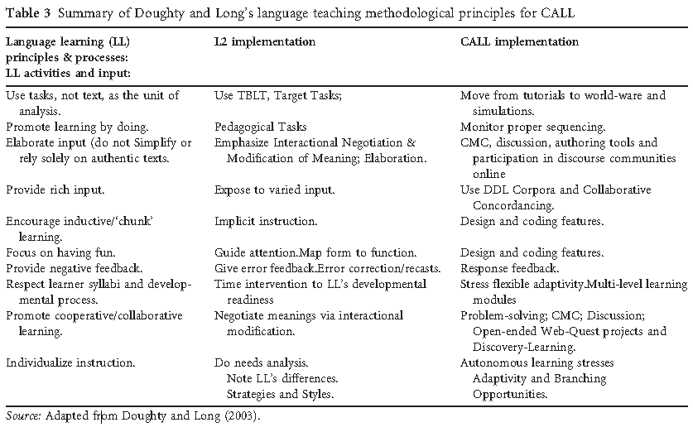
Loucky’s Table 3

Slide 90
Caution! Be Prepared!
Obtaining assistance for computer glitches as technical problems (machine dysfunction) vs. coping with use of machines (how to use the machine or software).
Records data but doesn’t tell us what the student thinks they are doing (Goodfellow & Laurillard, 1994).
EFL: CARI Reading: students were more motivated by the interesting and novel way that material was presented, but the use has to be monitored for effectiveness as the initial novelty eventually wears off (Lim & Shen, 2006 ).

Slide 91
Computer Resources
Division One: Kindergarten to Grade 3
http://www.vocabulary.com.il/games2/vocquiz.php - fun vocabulary
www.starfall.com - phonics and early reading
www.digitaldialects - basic vocabulary
www.learnalberta.ca - teacher resources & locked interactive sections
www.eslgold.com - teacher & student resources in 4 skills
www.kurzweiledu.com - software
www.googletranslate - translates several languages
www.hugosite.com - English video lesson series
www.englishtalkworld.multiply.com - sign up
http://www.free-english-study.com - learn 4 skills online
http://www.theroadmap.ca/home - reading reference resource

Slide 92
Division 2: Grades 4 to 6
http://www.digitaldialects.com/English.htm
http://en.childrenslibrary.org/
http://www.eslgold.com/
http://itunes.apple.com/us/app/a-english-speak-read-audio/id338982960?mt=8
http://itunes.apple.com/us/app/kaplan-toefl-vocabulary-flashcards/id310112006?mt=8
http://itunes.apple.com/us/app/pocket-english-eslbeginner/id316487889?mt=8
http://itunes.apple.com/us/app/vocabwiz-toefl/id319509494?mt=8
http://www.languagegames.org/
http://www.lextutor.ca/
http://www.onestopenglish.com/
http://www.rosettastone.com/
http://www.speak-english-today.com/
http://www.storyplace.org/eel/eel.asp
http://www.transparent.com/language-resources/games/
http://www.wordchamp.com/

Slide 93
Division 3: Grades 7 to 12
www.wordchamp.com – Archive, review, recycle
www.lingro.com – Access, meaning, acquire
www.readingenglish.net – All consolidating strategies
www.vocabulary.com – All strategies
www.lingorilla.com – All consolidating strategies
www.lextutor.ca – Association
www.moodle.com – Reassess, behavioural archive

Slide 94
References
Adam, M. J. (1990). Beginning to read: Thinking and learning about print. Cambridge, MA: The MIT Press.
Alberta. (2011). LearnAlberta.ca in Education. Retrieved from http://www.learnalberta.ca/Home.aspx?lang=en
Amendum, S., & Fitzgerald, J. (2011). Reading instruction research for English-Language Learners in Kindergarten through Sixth Grade: The last twenty years. In McGill-Franzen, A. & Allington, R. L. (Eds.), Handbook of reading disability research (pp.373-391). New York, NY: Routledge.
Apple. (2010a). A+ English. Retrieved from http://itunes.apple.com/us/app/a-english-speak-read-audio/id338982960?mt=8
Apple. (2010b). Kaplan vocabulary flashcards. Retrieved from http://itunes.apple.com/us/app/kaplan-toefl-vocabulary-flashcards/id310112006?mt=8
Apple. (2010c). Pocket English. Retrieved from http://itunes.apple.com/us/app/pocket-english-eslbeginner/id316487889?mt=8
Apple. (2010d). Vocabwiz. Retrieved from http://itunes.apple.com/us/app/vocabwiz-toefl/id319509494?mt=8
Chapelle, C. & Jamieson, J. (1986). Computer-Assisted Language Learning as a predictor of success in acquiring English as a Second Language. TESOL Quarterly, 20(1), 27-46.
Cobb, T. (n.d.). LexTutor. Retrieved from http://www.lextutor.ca/
Daud, N. M. (1992). Issues in CALL implementation and its implications on teacher training. Calico Journal , 10 (1), 69-78.
Druin. A, Bederson. B.B., Carlson Weeks, A., Hu C., Quinn, A., Massey, S., Ramos. M. (n.d.). International Children’s Digital Library. Retrieved from http://en.childrenslibrary.org/

Slide 95
Elam, S. (2005). Phonics Primer in The National Right to Read Foundation. Retrieved from http://www.nrrf.org/PhonicsPrimer.pdf
EPEARL. (n.d.). The CSLP portfolio project [image]. Retrieved from http://grover.concordia.ca/epearl/promo/en/index.php
ESL Gold. (2009). Speak English Today. Retrieved from http://www.speak-english-today.com/
ESL Gold. (2010a). Retrieved from http://www.eslgold.com/
ESL Gold. (2010b). The Oxford picture dictionary. Retrieved from http://www.eslgold.com/vocabulary/oxford_dictionary_cd.html
ESL Gold. (2010c). Pronunciation power. Retrieved from http://www.eslgold.com/pronunciation/pronunciation_power_1.html
ESL Gold. (2010d). Understanding and using English grammar. Retrieved from http://www.eslgold.com/grammar/understanding_using.html
Free English Study. (2007). Retrieved from http://www.free-english-study.com/
Gibson, C. (2007). Digital dialects. Retrieved from http://www.digitaldialects.com/English.htm
Goodfellow, R., & Laurillard, D. (1994). Modeling learning processes in lexical CALL. Calico Journal, 11(3), 19-46.
Ghadirian, S. (2007). Reading English. Retrieved from http://www.readingenglish.net/
Hayward, D. (2011) . University of Alberta. EDPY 458 (B1) Assessment and programming for children with specific reading disabilities.
Hoover, W. A., & Gough, P. B. (2011). The reading acquisition framework – An overview in SEDL: Cognitive Framework. Retrieved from http://www.sedl.org/reading/framework/overview.html

Slide 96
ICDL. (n.d.). International Children’s Digital Library. Retrieved from http://en.childrenslibrary.org/
Ladson-Billings, G. (1995). But that’s just good teaching! The case for culturally relevant pedagogy. Theory into Practice, 34(3), 159 -165.
Lalonde, C. (2009). Jean Piaget Society. Retrieved from: http://www.piaget.org/contact.html
Language Games. (n.d.). Retrieved from: http://www.languagegames.org/
Lee, K. (2000). English teachers’ barriers to the use of Computer-Assisted Language Learning. The Internet TESL Journal, 6(12). Retrieved from http://iteslj.org/Articles/Lee-CALLbarriers.html
Lim, K. M., & Shen, H. Z. (2006). Integration of computers into an EFL reading classroom. ReCALL , 18 (2), 212-229. Retrieved from http://journals.cambridge.org/action/displayAbstract?fromPage=online&aid=534812
Lingorilla.com. (2012). Home page. Retrieved from http://www.lingorilla.com/index.php?
Loucky, J.P. (2010). Constructing a roadmap to more systematic and successful online reading and vocabulary acquisition. Literary and Linguistic Computing, 25(2), 225-241.
Kump, L. (n.d.) Questioning to understand in ReadingLady.com. Retrieved from http://readinglady.com/index.php?&MMN_position=1:1
Lingro. (n.d.). Home page. Retrieved from http://lingro.com/
Macmillan English Campus. (2011). One Stop English. Retrieved from: http://www.onestopenglish.com/
McCarthy, C. P. (1999). Reading theory as a microcosm of the four skills. The Internet TESL Journal. Retrieved from http://indigo.ie/~sdblang/personal/papers/papers.htm

Slide 97
Mecklenberg, C. (2010). Story place: The children’s digital library. Retrieved from http://www.storyplace.org/storyplace.asp
Moodle. (n.d.). About. Retrieved from http://moodle.org/about/
NRRF. (2010). Phonics primer in The National Right to Read Foundation. Retrieved from http://www.nrrf.org/PhonicsPrimer.pdf
Oczkus, L. (2004). Super six reading strategies: 35 lessons and more for reading success. Norwood, MA: Christopher Gordon Publishers.
O’Donnell, A ., Reeve, J., & Smith, J. (2007). Educational psychology: Reflection for action. New Jersey.: Wiley Publishers.
OneStopEnglish. (2011). Retrieved from http://www.onestopenglish.com/
Rosetta Stone Ltd . (2011). Retrieved from: http://www.rosettastone.com/
Simmons, D., & Kameenui , E. J. (1998) . Word recognition: Research bases. In D.C. Simmons & E. J. Kameenui (Eds.), What reading research tells us about children with diverse learning needs: Bases and basics (pp. 141-167). Mahwah, NJ: Lawrence Erlbaum Associates.
Singhal (1998). A comparison of L1 and L2 reading: Cultural differences and schema. The Internet TESL Journal. Retrieved from
http://www.gse.uci.edu/ed168/resume.html

Slide 98
Soe, K., Koki, S. & Chang, J. M. (2000). Effects of computer-assisted instruction (CAI) on reading achievement: A meta-analysis in Pacific Resources for Education and Learning. Retrieved from http://www.prel.org/products/products/effect-cai.htm
Transparent Language. (2011). Retrieved from http://www.transparent.com/language-resources/games/
Vocabulary.com. (2012). Retrieved from http://www.vocabulary.com/
Vygotsky, L. S. (1978) Mind in society: The development of higher psychological processes (M. Cole, V. John-Steiner, S. Scribner, & E. Souberman, Eds. And Trans.). Cambridge, MA: Harvard University.
WordChamp. (2012). The language learning network. Retrieved from http://www.wordchamp.com/lingua2/Home.do
Watterson, B. (1988). The essential Calvin and Hobbes. New York, NY: Universal Press.

